Slide 1
Control Flow Integrity
--Sri Harsha, CyberEye.

Slide 2
Behaviour-based detection
Stack canaries, non-executable data, and ASLR aim to complicate various steps in a standard attack
But they still may not stop it.
Idea: observe the program’s behaviour - is it doing what we expect it to?
If not, might be compromised
Challenges
Define “expected behaviour”
Detect deviations from expectation efficiently
Avoid compromise of the detector

Slide 3
Control-flow Integrity (CFI)
Define “expected behaviour”
Control flow graph (CFG)
Detect deviations from expectation efficiently
In-line reference monitor (IRM)- An IRM is a rewriting of the program, where the instructions that are inserted check whether or not the CFI property is maintained.
Avoid compromise of the detector
Sufficient randomness, immutability

Slide 4
Efficient?
Classic CFI (2005) imposes 16% overhead on average, 45% in the worst case
Works on arbitrary executables
Not modular (no dynamically linked libraries)
Modular CFI (2014) imposes 5% overhead on average, 12% in the worst case
C only (part of LLVM)
Modular, with separate compilation
http://www.cse.lehigh.edu/~gtan/projects/upro/

Slide 5
Secure?
MCFI can eliminate 95.75% of ROP gadgets on x86-64 versions of SPEC2006 benchmark suite
By ruling their use non-compliant with the CFG
Average Indirect-target Reduction (AIR) > 99%
AIR is, in essence, the percentage of possible targets of indirect jumps that CFI rules out

Slide 6




Call
Graph
sort2(int a[], int b[], int len)
sort(a, len, lt);
}
bool lt(int x, int y) {
return x<y;}
bool gt(int x,int y) {
return x>y;}
{
^{sort(b, len, gt);}
sort2
lt
sort
gt
Which functions call other functions

Slide 7






Control
Flow
Graph
sort2(int a[],int b[],int len)
sort(a,len,lt);
}
bool lt(int x, int y) { return x<y;}
bool gt(int x, int y) {
return x>y;}
{
^{sort(b, len, gt);}
sort2
lt
sort
gt
Break
into basic blocks
Distinguish calls from returns

Slide 8
CFI: Compliance with CFG
Compute the call/return CFG in advance
During compilation, or analyze the binary
Monitor the control flow of the program and ensure that it only follows path allowed by the CFG
Observation: Direct calls need not be monitored
Assuming the code is immutable, the target address cannot be changed
Therefore: monitor only indirect calls
Jmp, call, ret with non-constant targets

Slide 9
In-line Monitor
Implement the monitor in-line, as a program transformation
Insert a label just before the target address of an indirect transfer
Insert code to check the label of the target at each indirect transfer
Abort if the label does not match
The labels are determined by the CFG

Slide 10











Simplest
labeling
label L
sort2
lt
sort
label L
label L
gt
label L
label L
all targets
ok…
system
Use the same label
at
Blocks
return to the start of direct-only call targets
_{but not incorrect ones}

Slide 11
Detailed
labeling
label M
sort2
lt
sort
label L
label N
gt
label L
ok…
label M
Constraints:
Return sites from calls to sort must share a label (L)
Call targets gt and lt must share a label (M)
Remaining label unconstrained (N)
Still permits call from site A to return to site B

Slide 12
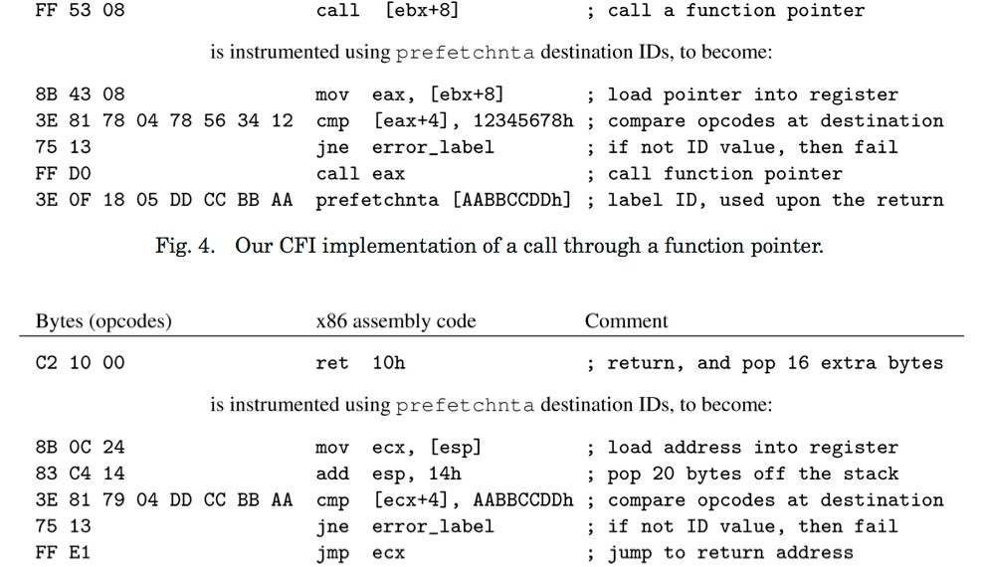








Classic CFI instrumentation
Check target label
Check target label

Slide 13
Can we defeat CFI?
Inject code that has a legal label
Won’t work because we assume non-executable data
Modify code labels to allow the desired control flow
Won’t work because the code is immutable
Modify stack during a check, to make it seem to succeed
Won’t work because adversary cannot change registers into which we load relevant data
No time-of-use bug (TOCTOU)

Slide 14
CFI Assurances
CFI defeats control flow-modifying attacks
Remote code injection, ROP/return-to-libc, etc.
But not manipulation of control-flow that is allowed by the labels/graph
Called mimicry attacks
The simple, single-label CFG is susceptible to these
Nor data leaks or corruptions
Heartbleed would not be prevented
Nor the authenticated overflow
Control modification is allowed by graph
void func(char *arg1)
{
int authenticated=0;
char buffer[4];
strcpy(buffer, str);
if(authenticated) { …..
}

